Slide 1

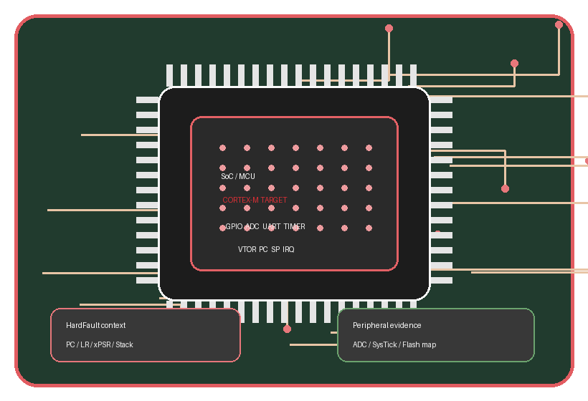
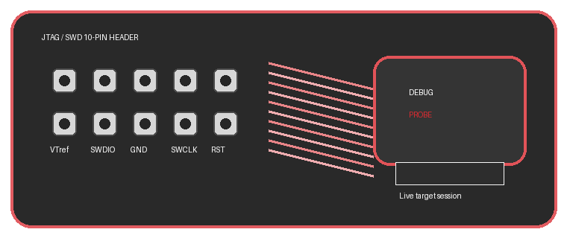
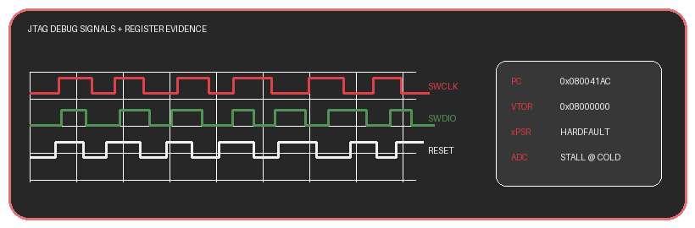
CONNECTED EMBEDDED DATA.
EMBEDDED DEBUG VISUAL STACK
HONEYWELL
REAL JTAG + MCU EVIDENCE.
SoC / MCU + PCB traces + JTAG probe + register evidence
AEPLO turns SoC / MCU debug signals into traceable PDLC decisions across PG1, PG3 and PG5.
WHAT STANDS OUT
SoC / MCU close-up
Cortex-M target context, vector table, ADC, SysTick, flash map
JTAG/SWD header + probe
10-pin header, SWDIO, SWCLK, reset and live target session
JTAG AGENT USE CASES
HardFault RCA Cold ADC emulation Boot config trace Peripheral state proof
Debug evidence overlay
PC, VTOR, xPSR, stack and waveform signals become AI context
PDLC impact loop
Jira, Confluence, GitHub, Copilot and AEPLO gate decisions
DEBUG SIGNALS + REGISTER EVIDENCE
Jira
Confluence
GitHub
Copilot
ROVO
MCP
JTAG/SWD
DEMO IMPACT
41%
60%
92%
96%
PG1
>
PG3
>
PR
>
PG5
>
QA
lead-time drop
fewer escapes
agent handoff
JSON accuracy
risk
RCA
fix
gate
learn
Better Together. Built for Embedded PDLC Impact.
SoC / MCU | PCB traces | JTAG/SWD | ROVO Studio | Copilot | Atlassian MCP | GitHub | Jira | Confluence

